Slide 1
Getting Started With Bootstrap 3

Slide 2
Getting Started
How do you actually use Bootstrap?
You need access to the CSS code and JS code.
Options:
Download copy
Use absolute reference
Link on CodePen

Slide 3
Saving your own copy of Bootstrap
You can download a copy of Bootstrap at http://getbootstrap.com
Use the default values or select http://getbootstrap.com/customize/
Make sure you know where you saved your files!

Slide 4
Using a CDN
A CDN is a content delivery network
Provides a way to connect to the Bootstrap code using an absolute reference
http://getbootstrap.com/getting-started/

Slide 5
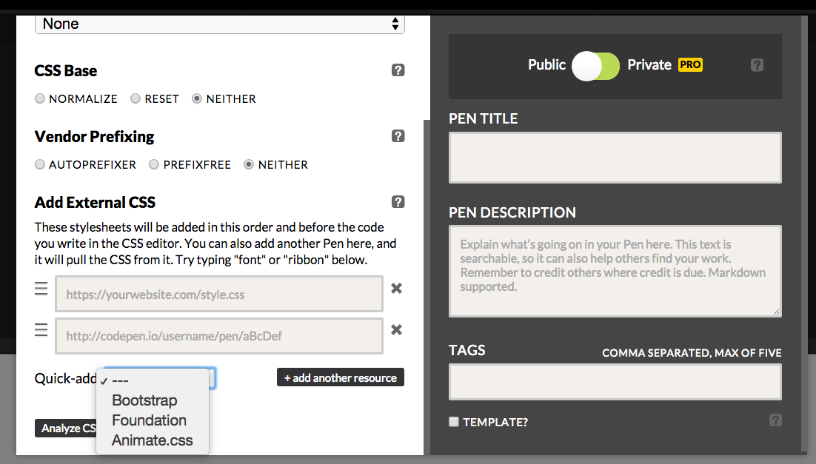
Using Bootstrap with CodePen
You can add Bootstrap to CodePen in the Settings.
Select Settings → CSS→ Add external CSS

Slide 6
Template
It is common to start with a template file.
http://getbootstrap.com/getting-started/#examples
A modified version from getbootstrap.com can be found here:
RD:Bootstrap Template

Slide 7
How do you know it is working?
For such a simple file, it may be hard at first to see if it is working.
To test:
Comment out link to css
Use Inspect Element
This method is definitely preferred, particularly as you start to add your own styles.

Slide 8
Don’t forget…
To use element inspector.
To include the JavaScript at the bottom.
That you can customize bootstrap defaults.
That you can overwrite bootstrap defaults.

Slide 9

Acknowledgements/Contributions
These slides are Copyright 2016- Colleen van Lent as part of http://www.intro-webdesign.com/ and made available under a Creative Commons Attribution NonCommercial 4.0 License. Please maintain this last slide in all copies of the document to comply with the attribution requirements of the license. If you make a change, feel free to add your name and organization to the list of contributors on this page as you republish the materials.
Initial Development: Colleen van Lent , University of Michigan School of Information

